Slide 1
#07 Web Security
Client/Server Computing and Web Technologies

Slide 2
Major security issues
Prevent unauthorized users from accessing sensitive data
Authentication: identifying users to determine if they are one of the authorized ones
Access control: identifying which resources need protection and who should have access to them
Prevent attackers from stealing data from network during transmission
Encryption (usually by Secure Sockets Layer)
Notes:
1) Protect data on storage; 2) protect data on network.

Slide 3
Authentication
Collect user ID information from end users (“logging in”)
usually by means of browser dialog / interface
user ID information normally refers to username and password
Transport collected user ID information to the web server
unsecurely (HTTP) or securely (HTTPS = HTTP over SSL)
Verify ID and passwd with backend Realms (“security database”)
Realms maintain username, password, roles, etc., and can be organized by means of LDAP, RDBMS, Flat-file, etc.
Validation: the web server checks if the collected user ID & passwd match with these in the realms.
Keep track of previously authenticated users for further HTTP operations
Notes:
Authentication in web environment is different from login to a computer, it requires SSL for transmission of usrname/passwd and session track!
SSL first
The realm attribute (case-insensitive) is required for all authentication schemes which issue a challenge. The realm value (case-sensitive), in combination with the canonical root URL of the server being accessed, defines the protection space. These realms allow the protected resources on a server to be partitioned into a set of protection spaces, each with its own authentication scheme and/or authorization database.

Slide 4
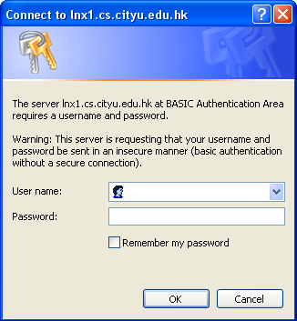
BASIC Authentication
Is BASIC authentication good enough?
Disadvantages
No customization is allowed (e.g. no user defined GUI or login pages)
Can only get username and password by default
Notes:
Configure in apache only
# htpasswd -c /etc/users calvin
AuthUserFile /etc/users
AuthName "This is a protected area"
AuthGroupFile /dev/null
AuthType Basic
Require valid-user

Slide 5
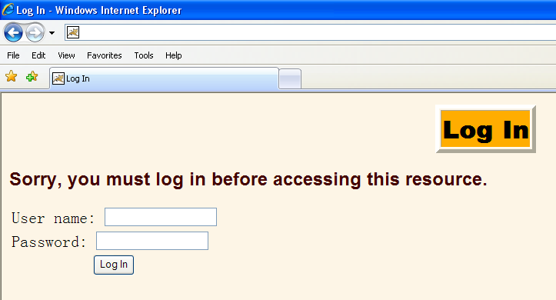
Form-based Authentication
Web server collects user identification information via a customized login page, e.g.
Notes:
Demo: comment “BASIC” block and uncoment “Form” block in web.xml file.

Slide 6
Basic vs. Form-based
Basic | Form-based
Get username and password by using browser provided dialog box | Get username and password by using a customized login page
Only username and password can be collected | Customized data can be collected
HTTP Authentication header is used to convey username and password | Form data is used to convey username and password

Slide 7
Basic password scheme
Hash function h : strings → strings
Given h(password), hard to find password
No known algorithm better than trial and error
User password stored as h(password)
When user enters password
System computes h(password)
Compares with entry in password file
No passwords stored on disk

Slide 8
Secure Sockets Layer (SSL)
A protocol developed in 1996 by Netscape for securely transmitting private web documents over the Internet.
It employs private and public key to encrypt data that’s transmitted over the SSL connection.
By convention, URLs that require SSL connection start with https: (port 443) instead of http: (port 80).
SSL is necessary if …
There is a login or sign in (to protect user name and passwd)
It transmits sensitive data online, such as credit card information, HKID #, etc.
You need to comply with privacy and security requirements

Slide 9
Use of an SSL Certificate
To enable secured SSL connections, the server needs an SSL certificate signed by a Certificate Authority (CA).
CA verifies the ID of the certificate owner (e.g., www.hsbc.com.hk) when an SSL certificate is issued.
Each SSL Certificate contains unique and authenticated information about the certificate owner, such as ID (in X.500 format), location, public key, and the signature of the CA.
It confirms that you are who you say you are in the Internet.
An SSL certificate enables encryption of sensitive information during online transactions by means of using hybrid cryptosystem.
Notes:
Only a server needs a certificate (browser only chooses to accept this certificate or not. See protocol next page), which is sufficient to establish session key for subsequent secret comm between client & server. Browser doesn’t need to have a certificate.

Slide 10
A Sample Certificate
This is a certificate issued by Ace CA:
Data
Version: v1 (0x0)
Serial Number: 1 (0x1)
Signature Algorithm: PKCS #1 MD5 With RSA Encryption
Issuer: OU=Ace Certificate Authority, O=Ace Ltd, C=US
Validity: Not Before: Fri Nov 15 00:24:11 1996
Not After: Sat Nov 15 00:24:11 1997
Subject: CN=Jane Doe, O=Ace Industry, C=US
Subject Public Key Info:
Algorithm: PKCS #1 RSA Encryption
Public Key: 00:d0:e5:60:7c:82:19:14:cf:38: F7:5b:f7:35:4e:14:41:2b:ec:24:
33:73:be:06:aa:3d:8b:dc:0d:06: 35:10:92:25:da:8c:c3:ba:b3:d7:
lf:1d:5a:50:6f:9a:86:53:15:f2: 53:63:54:40:88:a2:3f:53:11:ec: 68:fa:e1:f2:57
Public Exponent: 65537 (0x10001)
Signature
Algorithm: PKCS #1 MD5 With RSA Encryption
Signature: 12:f6:55:19:3a:76:d4:56:87:a6: 39:65:f2:66:f7:06:f8:10:de:cd:
1f:2d:89:33:90:3d:a7:e3:ec:27: ac:e1:c0:29:c4:5a:69:17:51:dc:
1e:0c:c6:5f:eb:dc:53:55:77:01: 83:8f:4a:ab:41:46:02:d7:c8:9a: fe:7a:91:5c
Notes:
This certificate in SSL is for web-server, to identify if the server is trustable:
Data & signature parts;
Data part in details;
Signature part in details.

Slide 11


How SSL Works?
Browser connects to SSL port 443 on the web server, and Hello msg exchange btn browser & server on key-exchange, encrypt alg, etc
SSL handshake
Web server sends back its SSL certificate. Web browser decides if it wants to trust the web server’s SSL certificate
Web browser and web server both calculate a session key by agreed key-generation method
Web Browser
Web browser and web server negotiate an encryption cipher
Web Server
Web browser and web server exchange information encrypted by the session key and the agreed encryption algorithm
Notes:
e.g., client clicks a “login” icon, it is re-directed to a https login page. After the above 4 hand-shaking steps of SSL, in step 5, user’s login-name and passwd is encrypted and sent to the web-server.

Slide 12
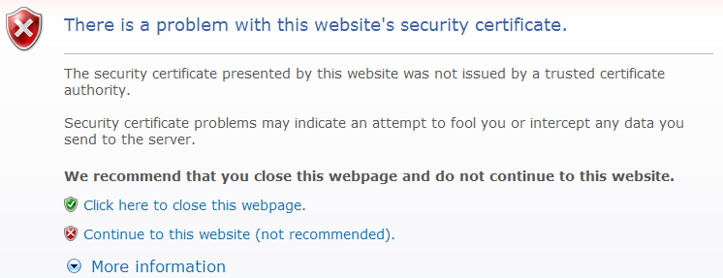
CA Root Certificate
Web browser needs the root certificate of the CA that issued the SSL certificate to the web-server to verify if the web server is trustable.
If the browser does not have/trust the CA root certificate, most web browsers will warn you …
Notes:
Eg. CSlab webmail (most internal security system simply get a certificate from anywhere).

Slide 13
Social Web Integration
In a typical web authentication model, user owning the resource shares credentials with other applications to provide them access to their protected data
The above approach presents significant challenges for the resource owners
It requires sharing of passwords in clear text which third party applications stores for any future use
Any compromise of third party application results in compromise of user’s password and its data
Resource access revocation is only possible by user through password change
Third party applications have full access to user’s data i.e. no data level or data scope access
Notes:
Content Slide: This is usually the most frequently used slide in every presentation.
Use this slide for Text heavy slides. Text can only be used in bullet points
Title Heading – font size 30, Arial bold
Slide Content – Should not reduce beyond Arial font 16
If you need to use sub bullets please use the indent buttons located next to the bullets buttons in the tool bar and this will automatically provide you with the second, third, fourth & fifth level bullet styles and font sizes
Please note you can also press the tab key to create the different levels of bulleted content

Slide 14
OAuth
OAuth stands for “Open Authorization”
An open standard protocol that provides simple and secure authorization for different types of applications
A simple and safe method for consumers to interact with protected data
Allows providers to give access to users without any exchange of credentials
Designed for use only with HTTP protocol. It does not support any other protocol
Notes:
Content Slide: This is usually the most frequently used slide in every presentation.
Use this slide for Text heavy slides. Text can only be used in bullet points
Title Heading – font size 30, Arial bold
Slide Content – Should not reduce beyond Arial font 16
If you need to use sub bullets please use the indent buttons located next to the bullets buttons in the tool bar and this will automatically provide you with the second, third, fourth & fifth level bullet styles and font sizes
Please note you can also press the tab key to create the different levels of bulleted content

Slide 15
Why OAuth?
It is flexible, compatible and designed to work with mobile devices and desktop applications
Provides a method for users to grant third-party access to their resources without sharing their credentials.
Provides a way to grant limited access in terms of scope and duration
Has support from big players in the industry
Facebook's Graph API
Foursquare
Github
Google
Salesforce
Windows Live

Slide 16
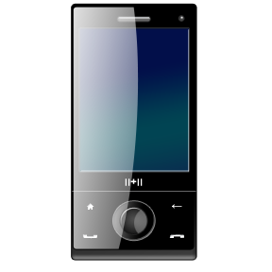

Introduction
User accesses consumer application which first gets user authenticated through API Provider application for any exchange of information
Once authenticated, consumer application and Provider exchange tokens for authorization
After successful authorization, consumer application gets access to users resources on Provider application
Data Exchange
Access
Consumer
Application
API
Provider
User
Notes:
Content Slide: This is usually the most frequently used slide in every presentation.
Use this slide for Text heavy slides. Text can only be used in bullet points
Title Heading – font size 30, Arial bold
Slide Content – Should not reduce beyond Arial font 16
If you need to use sub bullets please use the indent buttons located next to the bullets buttons in the tool bar and this will automatically provide you with the second, third, fourth & fifth level bullet styles and font sizes
Please note you can also press the tab key to create the different levels of bulleted content

Slide 17
Building Blocks
Roles
Registration
Tokens
Profiles
Authorization
Flows
Grants
Endpoints
Request/Response
Parameters
Notes:
Content Slide: This is usually the most frequently used slide in every presentation.
Use this slide for Text heavy slides. Text can only be used in bullet points
Title Heading – font size 30, Arial bold
Slide Content – Should not reduce beyond Arial font 16
If you need to use sub bullets please use the indent buttons located next to the bullets buttons in the tool bar and this will automatically provide you with the second, third, fourth & fifth level bullet styles and font sizes
Please note you can also press the tab key to create the different levels of bulleted content

Slide 18






Roles
Resource Owner
An entity referring to a system or a person (end-user) owning the resources
Client
An application that makes request for protected resources on behalf of Resource Owner with its authorization
Authorization
Grant Request
Authorization Server
Server responsible for issuing access tokens to the client after successfully authenticating the resource owner and obtaining authorization
Access Token
Request
Protected Resource
Access Request
Resource Server
An entity referring to a system or a person (end-user) owning the resources
The authorization server may be the same server as the resource server or a separate entity
Notes:
Content Slide: This is usually the most frequently used slide in every presentation.
Use this slide for Text heavy slides. Text can only be used in bullet points
Title Heading – font size 30, Arial bold
Slide Content – Should not reduce beyond Arial font 16
If you need to use sub bullets please use the indent buttons located next to the bullets buttons in the tool bar and this will automatically provide you with the second, third, fourth & fifth level bullet styles and font sizes
Please note you can also press the tab key to create the different levels of bulleted content

Slide 19
Client Registration
OAuth requires Clients to register with the authorization server before making any API requests
Protocol leaves the registration mechanism open to API Provider
As part of registration, OAuth expects
Client Type
Redirections URI(s)
Any other information required by API (data specific to the provider)
Example: Visit
http://code.google.com/apis/console
https://developers.facebook.com/apps
Successful registration results in issuance of credentials (Client ID & Client Secret) to client

Slide 20
Client Profiles
Server Side Web Application
Client is a server hosting the client application
When accessed by Resource Owner, Client Application makes API calls using appropriate programming language.
Secret or access tokens are not exposed to the user
Client requires repetitive access to protected resources
User Agent based Application
JavaScript, Flash plug-in, browser extension or any downloaded executing in browser could be OAuth client
Protocol data and credentials are easily accessible (and often visible) to the resource owner
There is no concern on token leakage to entrusted users or applications
Native Application
OAuth client is installed and executed on the resource owner’s device
Protocol data and credentials are accessible to resource owner
Official applications released by API provider

Slide 21
Tokens
OAuth protocol supports bearer tokens. Once authorized, using bearer token client can request to access resource
What is Bearer Token?
A security token is something that any party in possession of the token (a "bearer") can use the token in any way that any other party in possession of it can which requiring bearer to present proof-of-possession
Protocol defines two types of tokens used in the process
Access Token: required to access the protected resources. Represents the grant's scope, duration, and other attributes granted by the authorization grant
Refresh Token: used to obtain access tokens. Refresh tokens are issued to the client by the authorization server and are used to obtain a new access token when the current access token becomes invalid or expires etc.

Slide 22
Grant Types
Grant is a credential which represents owner’s authorization and used by client to access owner’s protected resources. Grant types defined by the specification
Authorization Code
Suited for Server Side Clients
Implicit
Optimized for User agent (browser) based clients
Resource Owner Password Credentials
Resource Owner’s credentials (username/password) could be used to obtain access token. Could be used by trusted clients like mobile application
Client Credentials
Typically used by application to obtain access token for resources owned by the client or if there is some offline authorization agreed with an authorization server

Slide 23
End Points
Endpoints are the URIs which Client uses to make requests. Protocol supports following authorization server endpoints
Authorization Endpoint
Endpoint used by client to obtain resource authorization from resource owner
Token Endpoint
Used by client to retrieve access or refresh token
Redirection Endpoint
Authorization server uses the endpoint to redirect after authorization process

Slide 24
Authorization Flows
OAuth defines four authorization flows
Server Side Web Application Flow
User Agent (Browser) Application Flow
Resource Owner Password Flow
Client Credentials Flow

Slide 25
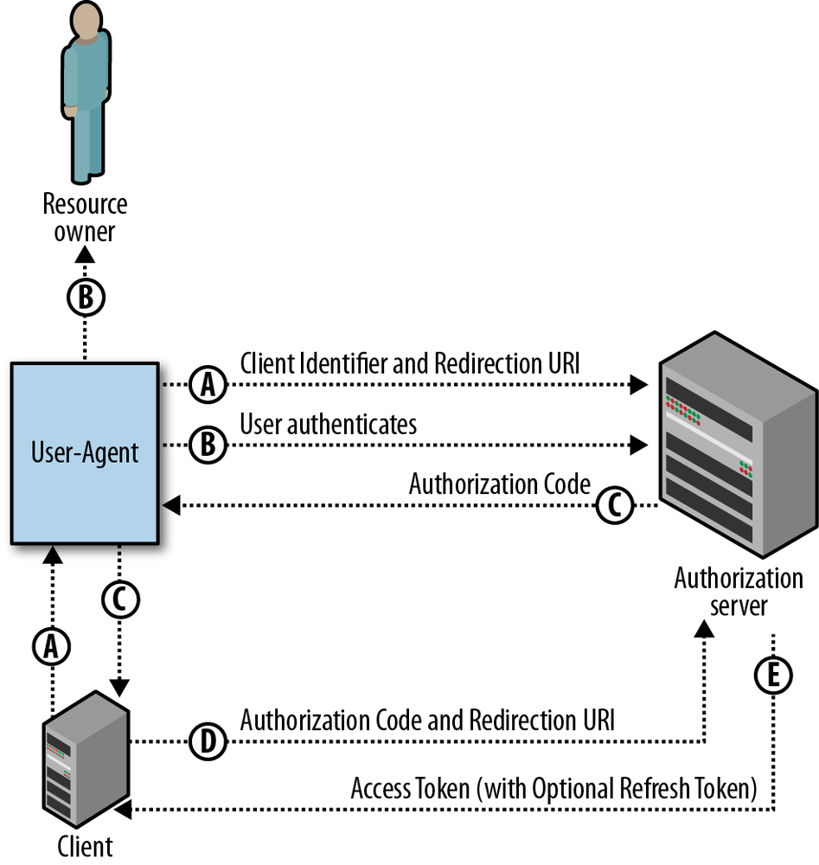
Server-Side Web Application Flow

Slide 26
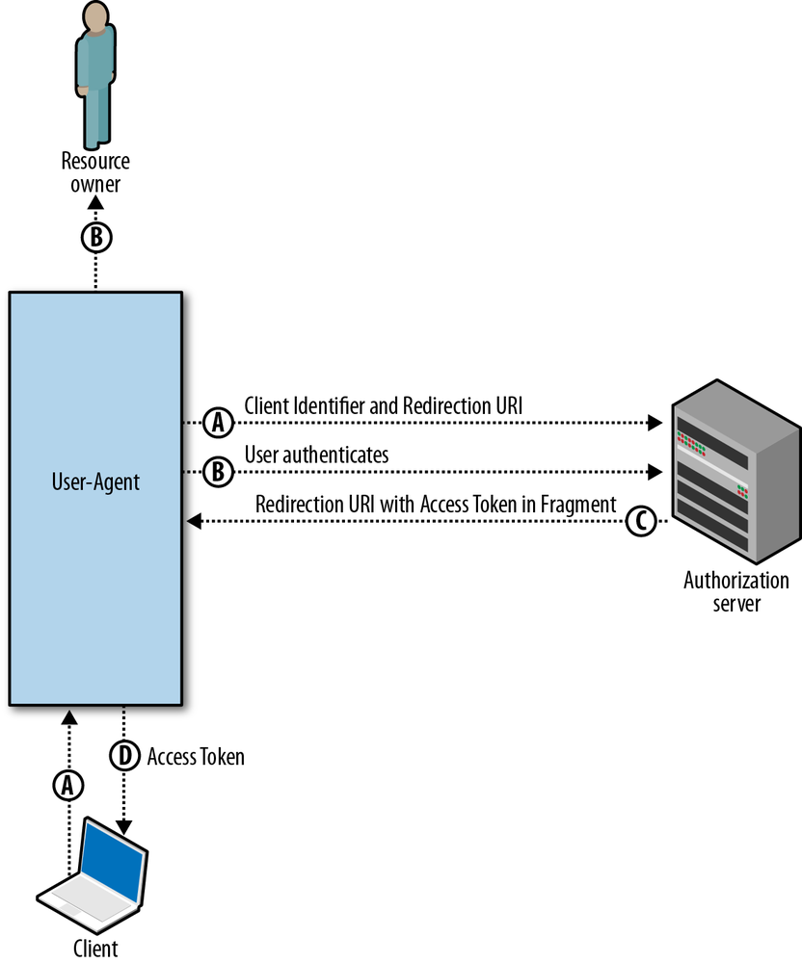
Client-Side Web Applications Flow

Slide 27
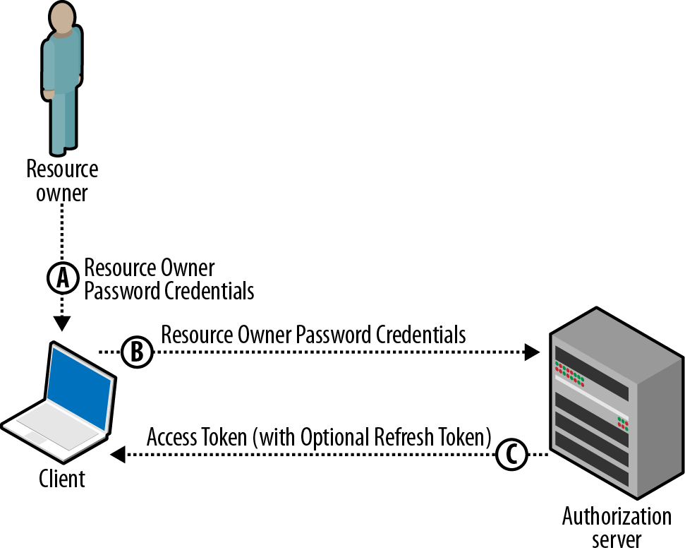
Resource Owner Password Flow

Slide 28
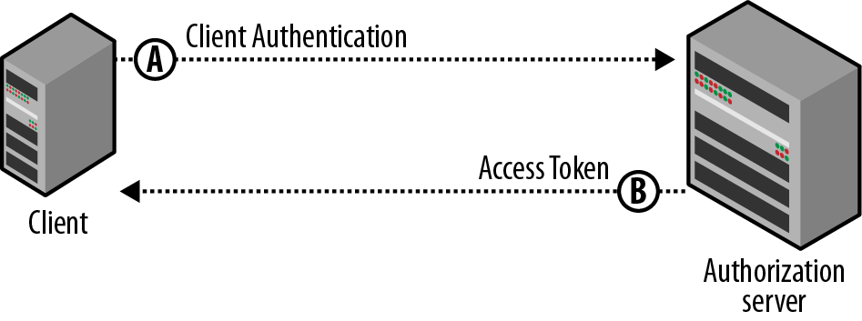
Client Credentials Flow

Slide 29
Passport
Passport is authentication middleware for Node.
It is designed to serve a singular purpose: authenticate requests.
Single sign-on using an OAuth provider such as Facebook or Twitter has become a popular authentication method.
Services that expose an API often require token-based credentials to protect access.
npm install passport

Slide 30
Facebook as a Passport Provider
An app at Facebook Developers must first be created.
When created, an app is assigned an App ID and App Secret.
Your application must also implement a redirect URL, to which Facebook will redirect users after they have approved access for your application.

Slide 31
Passport Configurations
var passport = require('passport')
, FacebookStrategy = require('passport-facebook').Strategy;
passport.use(new FacebookStrategy({
clientID: FACEBOOK_APP_ID,
clientSecret: FACEBOOK_APP_SECRET,
callbackURL: "http://www.ex.com/auth/facebook/callback"
},
function(accessToken, refreshToken, profile, done) {
User.findOrCreate(..., function(err, user) {
if (err) { return done(err); }
done(null, user);
});
}));
>> npm install passport-facebook
Notes:
https://scotch.io/tutorials/easy-node-authentication-facebook

Slide 32
Passport Routes
app.get('/auth/facebook', passport.authenticate('facebook'));
app.get('/auth/facebook/callback',
passport.authenticate('facebook', { successRedirect: '/',
failureRedirect: '/login' }
));
*without extra permissions
app.get('/auth/facebook',
passport.authenticate('facebook', { scope: ['read_stream', 'publish_actions'] })
);
*with multiple permissions
<a href="/auth/facebook">Login with Facebook</a>
Notes:
https://scotch.io/tutorials/easy-node-authentication-facebook
https://github.com/passport/express-4.x-facebook-example
https://x.coe.phuket.psu.ac.th/warodom/fb/
http://dev.werapun.com:3000/

Slide 33
Post to Facebook
// Specify the URL and query string parameters needed for the request
var url = 'https://graph.facebook.com/me/feed';
var params = {
access_token: access_token,
message: message
};
// Send the request
request.post({url: url, qs: params}, function(err, resp, body) {
// Handle any errors that occur
if (err) return console.error("Error occured: ", err);
body = JSON.parse(body);
if (body.error) return console.error("Error returned from facebook: ", body.error);
response.send(resp);
});
Notes:
http://code.runnable.com/VBnFwuj0MVYxnFgP/nodejs-facebook-publish-feed-for-node-js
[FB SDK v2.8: deprecated: cannot get access_token from: https://graph.facebook.com/oauth/access_token]
Facebook App: https://developers.facebook.com/apps/
Access token: https://developers.facebook.com/tools/access_token/
Graph API explorer: https://developers.facebook.com/tools/explorer/
FBGraph Lib: https://github.com/criso/fbgraph

Slide 34
References
"Web Security Programming", Xiaohua Jia
"OAuth 2.0", Amit Harsola
"OAUTH 2.0", Yasmine M. Gaber
"Passport: Facebook Providers", http://passportjs.org/guide/facebook/
"Post on Facebook", http://runnable.com/UTlPM1-f2W1TAABY/post-on-facebook

